Slide 1
PNB METLIFE DESIGN SPRINT

Slide 3
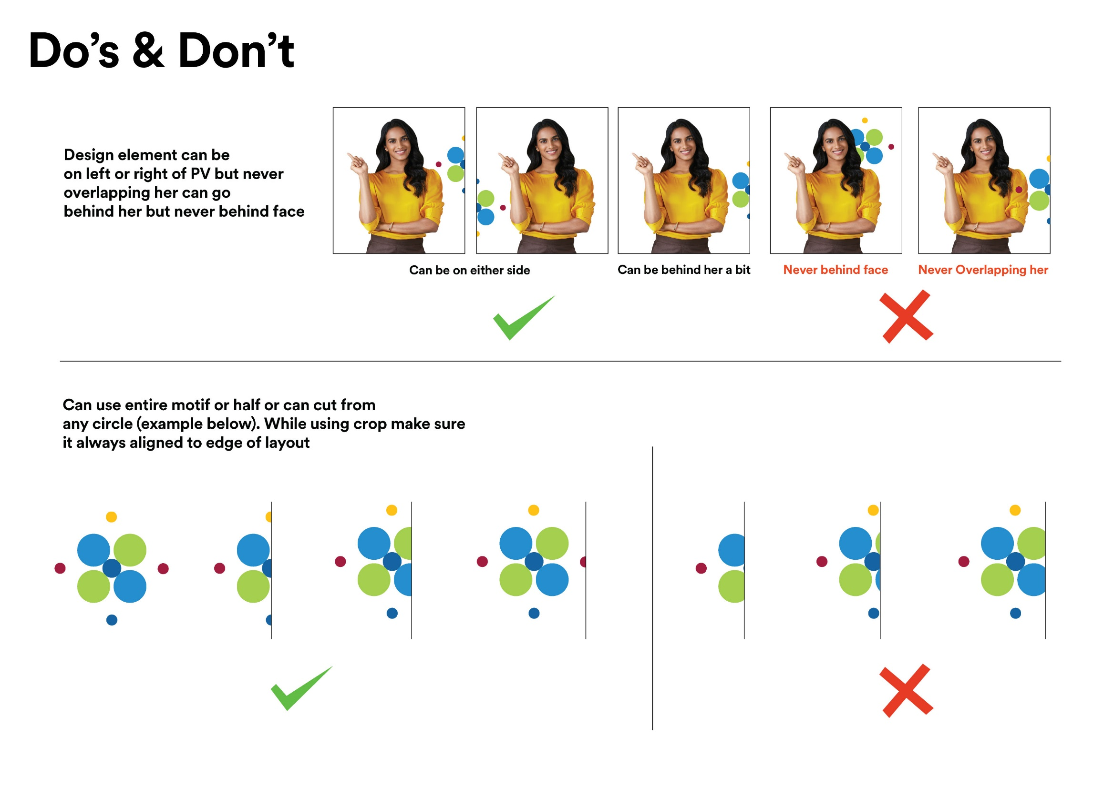

Slide 4
Use in creatives without PVS

Slide 5
Use in creatives without PVS

Slide 6
THANK YOU

